Slide 1
Base Number Systems
INFSCI 0010

Slide 2
Objectives – Oh Yes
Learn what the Base number system is about and how it functions. Base 2, 8, 10, and 16 will be the focus. Master how to convert between different bases.
Specifically, learn the positional notation concept
Learn how to add binary numbers together.
Understand why the number of bits is important in computer system.

Slide 3
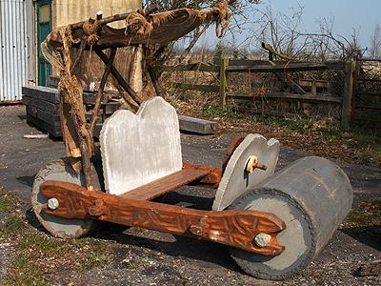
Numbers
Very early people used a hash based system of counting.
Example: Put a stick on the ground every day it rained. The number of days it rained = the number of sticks.
Not so good if you had a money system and someone wanted to buy a ten thousand dollar car

Slide 4
Milestones in the evolution of numbers
Around 4000 BC Sumerians counted goods and livestock. Basically a counting system using tokens
Around 3000 BC Egyptians created the number 1 to measure things. They used the length of the arm = cubit. Also used symbols such as a rope = 10.
Around 500 AD India creates the zero and positional notation!
Around 1646 – Liebnitz discovers binary numbers!

Slide 5
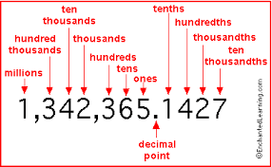
Position Notation Base 10
Base 10 – digits are 0-9
Ask how many 100's? 10's?
10,000 | 1000 | 100 | 10 | 1
4 | 8 | 3 | 2 | 6
10⁴ | 10³ | 10² | 10¹ | 10⁰
http://www.enchantedlearning.com/math/decimals/placevalue/

Slide 6
Algorithm for understanding value of any base
Step 1: Start with the decimal point and six positions to the left and two to the right:
Step 2: Take the Base you are working with and put that number under each position. In this example you will see a 2 for Base 2. If it was base 8 you would put an 8.
P6 | P5 | P4 | P3 | P2 | P1 | . | P-1 | P-2
P6 | P5 | P4 | P3 | P2 | P1 | . | P-1 | P-2
2 | 2 | 2 | 2 | 2 | 2 | . | 2 | 2

Slide 7
Algorithm for understanding value of any base
Step three: Add an ascending exponent starting with 0 to each one of the two's starting in the first position to the left of the decimal point. Add a negative ascending exponent starting with -1 for each position to the right of the decimal point.
Step four: Calculate the value for the positions that have a 2 and an exponent.
P6 | P5 | P4 | P3 | P2 | P1 | . | P-1 | P-2
2 | 2 | 2 | 2 | 2 | 2 | . | 2 | 2
2⁵ | 2⁴ | 2³ | 2² | 2¹ | 2⁰ | . | 2⁻¹ | 2⁻²
32 | 16 | 8 | 4 | 2 | 1 | . | 1/2 | 1/4
Step three
Step four

Slide 8
Algorithm for understanding value of any base
Step five: Determine how many digits you have available to you. It is one less than the Base number. So, Base 2 would be 0 and 1. Base8 would be 0-7.
Step six: To test, add some 1's and 0's to the positions and add their values.
32
08
04
01
1/2
45.5
SUM
P6 | P5 | P4 | P3 | P2 | P1 | . | P-1 | P-2
2 | 2 | 2 | 2 | 2 | 2 | . | 2 | 2
2⁵ | 2⁴ | 2³ | 2² | 2¹ | 2⁰ | . | 2⁻¹ | 2⁻²
32 | 16 | 8 | 4 | 2 | 1 | . | ½ | 1/4
1 | 0 | 1 | 1 | 0 | 1 | . | 1 | 0

Slide 9
Algorithm for understanding value of any base
Another way of seeing it:
Exponent
Position 6 has a value of 32 and there is one of them so put 32 in your add column. Next. Position 5 is worth 16 but there is a 0 so you don't have any. Position 4 is worth 8 and you have 1 so put an 8 in your add column and so on…
P6 | P5 | P4 | P3 | P2 | P1 | . | P-1 | P-2
2 | 2 | 2 | 2 | 2 | 2 | . | 2 | 2
2⁵ | 2⁴ | 2³ | 2² | 2¹ | 2⁰ | . | 2⁻¹ | 2⁻²
32 | 16 | 8 | 4 | 2 | 1 | . | ½ | 1/4
1 | 0 | 1 | 1 | 0 | 1 | . | 1 | 0
Exponent
Value
How Many?

Slide 10
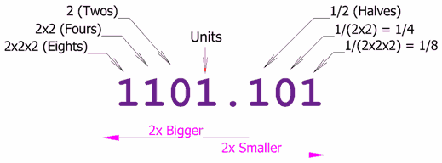
Positional Notation – Base 2- Binary
Base 2- digits are 0 and 1
Ask how many 8's? 4's 1's ? etc. Answer____?
2⁴ | 2³ | 2² | 2¹ | 2⁰ | = exponent
16 | 8 | 4 | 2 | 1 | = value
1 | 0 | 0 | 1 | 1 | = how many

Slide 11
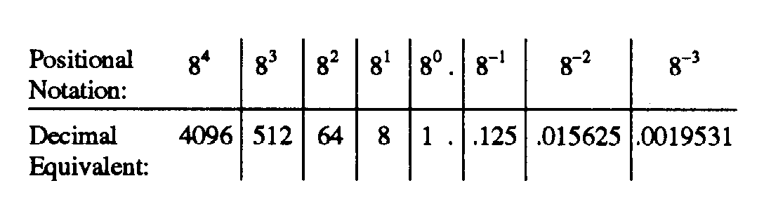
Positional Notation Base 8 - Octal
Base 8 – digits are 0 – 7
Ask how many 512's, 64's etc? Answer____?
8⁴ | 8³ | 8² | 8¹ | 8⁰ | ^{= base with exponent}
4096 | 512 | 64 | 8 | 1 | = value
1 | 0 | 3 | 2 | 4 | = how many

Slide 12
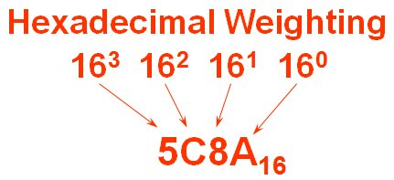
Positional Notation – Base 16 - Hexadecimal
Base 16 digits are 0 – 9 and A-F
We need the single letters A-F to represent the values 10, 11, 12, 13, 14 and 15 respectively. Answer -----?
16⁴ | 16³ | 16² | 16¹ | 16⁰ | ^{= base with exponent}
65536 | 4096 | 256 | 16 | 1 | = value
0 | 1 | A | 1 | F | = how many
1 A 1 F

Slide 13
Convert from Base 10 to other Base using Division/Remainder method
Divide decimal number by the base number and note the quotient and remainder
Divide the previous quotient by the base number and note the new quotient and remainder
Example: 12₁₀ to Base 2 – Read the remainder column from bottom up : 1100
Note: Good tutorial on conversion:
Step | Division by Base Number | Quotient | Remainder
Step 1 | 12/2 | 6 | 0
Step 2 | 6/2 | 3 | 0
Step3 | 3/2 | 1 | 1
Step 4 | 1/2 | 0 | 1

Slide 14
Convert from Base 10 to other Base – Try and Test Method
More of a try and test method
Start with laying out the position values of the Base 2 or other Base number system from right to left starting at base to exponent 0
For example lets do 38₁₀
Find the largest number that will divide into the number one time. So, first we put a 1 in the 32's slot and we subtract 32 from 38 and we have 6. Now, 16's is too big to go into 6 and so is 8 so we put 0's in those columns. However, one of those 4's would work leaving 2. Lastly, put a 1 in the 2's column. And a 0 in the last column. Add them up and see they equal 38
Note: Good tutorial on conversion:
2⁵ | 2⁴ | 2³ | 2² | 2¹ | 2⁰ | ^{exponent}
32's | 16's | 8's | 4's | 2's | 1's | values
1 | 0 | 0 | 1 | 1 | 0 | How many

Slide 15
How to convert any Base to Base x
Step 1 First, Convert to Base 10
Step 2 Convert to new Base by using remainder or try/test method
Example: Convert 13 in Base 8 to Base 2
Step 1 Base 8 position values are:
So, 13₈ ₌ 11₁₀
Use remainder or try/test method
64 | 8 | 1
 | 1 | 3
Base 8
How many
8 | 4 | 2 | 1
1 | 0 | 1 | 1
Base 2
How many

Slide 16
Some problems…
Find a partner and work together
Convert the following Base 2 numbers to Base 10:
0
1
10
101
What digits are available in the Base 16 system?
How many digits are available in any base number system?

Slide 17
Some problems…
Convert following Base 10 numbers to Base 2
0
10
15
32
What are the steps in division/remainder and try and test methods?
Convert 104 in Base 8 to Base 2.

Slide 18
Shortcut to convert between Base 2 and Base 16
Start with a Base 2 number such as 10010100011110
Section the number into groups of four from the right
0010 0101 0001 1110
If you don't have enough number on the left to make four numbers simply add zeroes.
Now convert each group of four into a Base 16 digit. The smallest 0000 would be 0 and the biggest 1111 would be F
SO, 251E_{16 is the answer.}

Slide 19
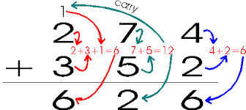
Binary Addition
There are four rules:
0 +0 = 0
0 + 1 = 1
1 + 0 = 1
1 +1 = 0 and carry 1
Also 1+ 1 +1 = 1 and carry 1
Lets review how we do Base 10 addition and apply to Base 2.
http://sandbox.mc.edu/~bennet/cs110/textbook/module3_1.html

Slide 20
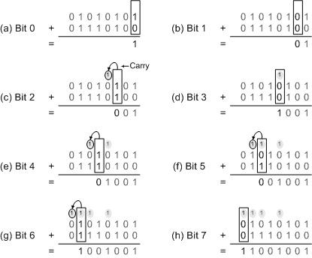
Binary Addition
Good tutorial on addition and subtraction:

Slide 21
What is the point?
Well, computers store information and perform math functions with binary numbers, hence binary numbers are key to understanding computer operations.
Often times bits are grouped into bytes (8 bits) therefore octal is important
Often time bits are grouped into 16 bits which is why hexadecimal is important.
We still need to connect electricity, binary numbers with math functions!
And we need to know how to represent letters and non-numbers!

Slide 22
ASCII CHART
Lets start with representing letters and other type marks. Remember a computer only stores numbers.
So a chart was created that gave a number to each letter, punctuation type marks and other symbols.
For example: The capital letter A is the number 65 and the small case b = 98.
So, when a computer is using text editor and reads from a file and comes across the number 65 it produces and A on the screen.

Slide 23
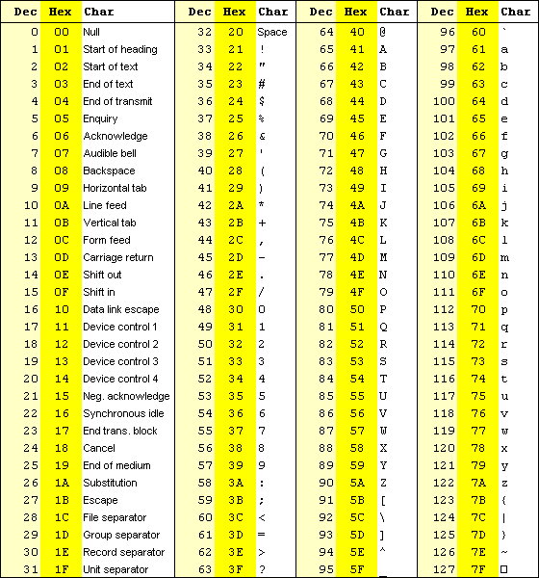
ASCII Chart
http://www.cdrummond.qc.ca/cegep/informat/Professeurs/Alain/files/ascii.htm

Slide 24
Class Problem
Write your first name in ASCII
Convert each number that represents each letter of your name to binary.
How would you add up all of the binary numbers of each of your letters of your name.
Lets do BOB – easy ☺
B = 66 O = 79 B= 66
What is 66, 79 and 66 in Base 2
How do you add three numbers in Base 2?
What is the answer?

Slide 25
Possibilities
Now that we know about binary numbers lets look at how many numbers can be represented or the idea of different states.
In a two bit system:
00 Think of a location in memory that hold two bits
01
10
11
We can represent four different states, colors or anything.
So, if we tied a pixel to this one set of bits, it could either be black, blackish-white, whitish – black or black.

Slide 26
Possibilities
Bit depth: Bit1 Bit2 Bit3
Lets see what happens when we have three bits
0 0 0
0 0 1
0 1 0
1 0 0
0 1 1
1 0 1
1 1 0
1 1 1
0 or 1
0 or 1
0 or 1
There are eight possibilities or different states (unique values) that can be represented. The formula for computing the number of possibilities is 2^{number of bits} The 2 represents how many possible numbers can be in a single bit. Because it is binary we have the digits 0 and 1. If it was Base 8 we would have 8 – 0 through 7.
So, if you had a 16 bit computer than you would have 2¹⁶ possibilities = 65,536.
For a deeper understanding visit this site.
Bit1 – Bit2 – Bit3

Slide 27
Class Problem
On a scale of 1-10 how much do you hate binary numbers?
Remember there are 10 types of people in the world : those who know binary and those who do not.

Slide 28
Possibilities
Oh Oh You Tube runs into problems with Gangham Style
https://plus.google.com/+youtube/posts/BUXfdWqu86Q

Slide 29
Where do we go from here?
Lets look at electricity in a computer
How does the computer actually use electricity to add or subtract
What are logic gates and integrated circuits.
Who is George Boole and what did he discover?
Our goal is to be able to "think" like a computer which will show us great possibilities but also limitations.

